Slide 1
Air Quality Visualization and Alert System
Team ‘Breath of Fresh Air’
Tressa Groelsma, Javier Ramirez, Chris Schertenlieb, Megan Thomas

Slide 2
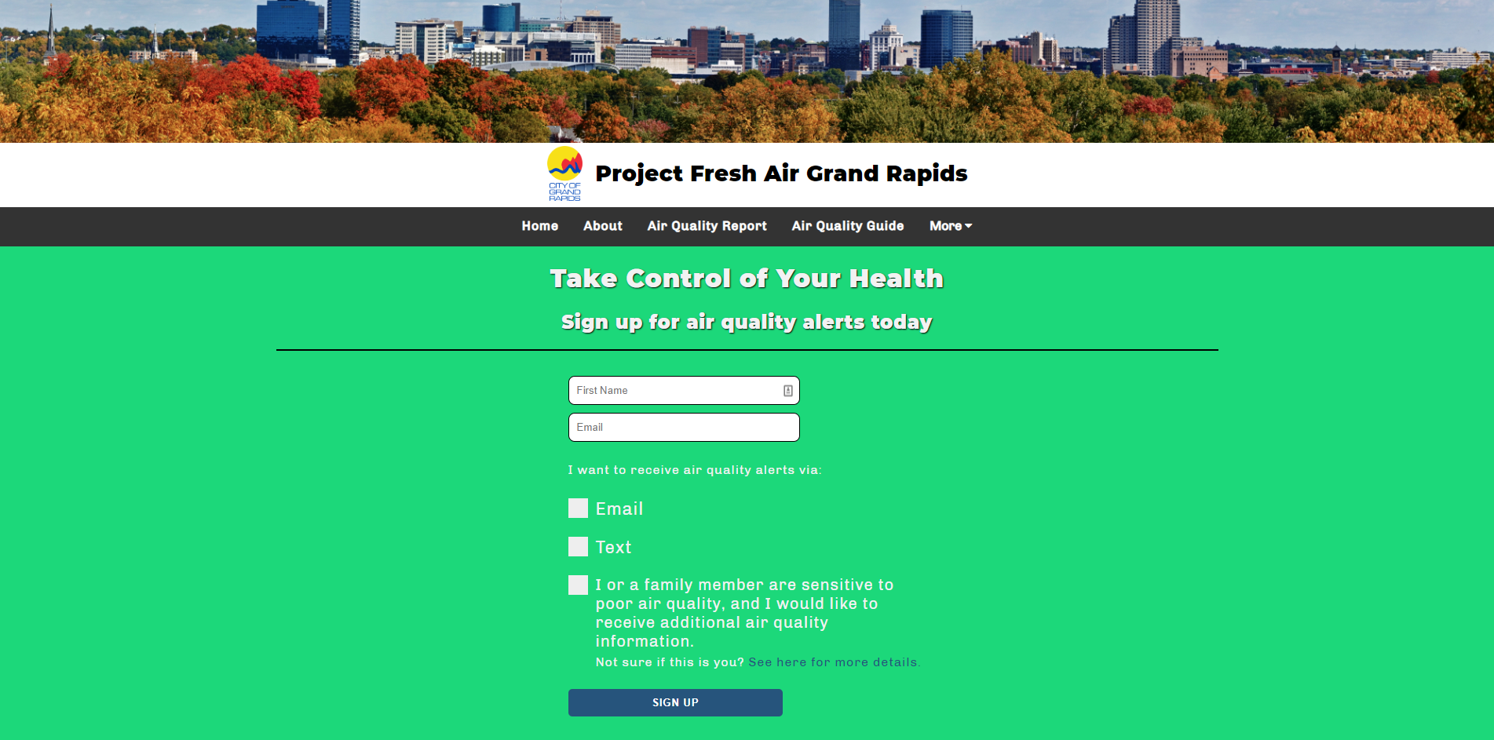
Goal
Inform citizens about the importance of air quality
Create a system to alert citizens to poor air quality in the area
Have an open source platform to download data on air quality

Slide 3
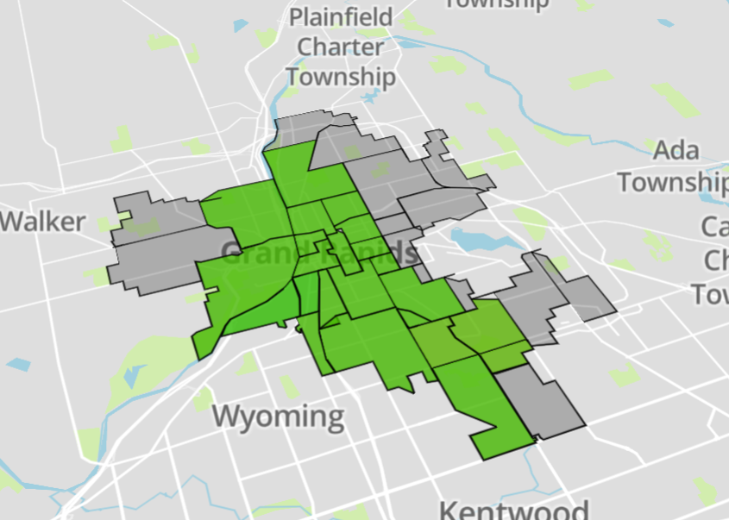
Solution
Web App
Django and Python
Data Management
Noise Reduction Techniques
Data Visualization
Plotly and Python
Alert System
Email and Text Alerts Scripts

Slide 4
Special Acknowledgements
Seamless IoT
OST
Mercy Health
Professor Engelsma

